Slide 1

Data-Driven College Scoring System
The College Scoring System is a new approach to ranking colleges. It is based on data from fees, placements, reviews, and rankings. The system analyzes multiple data sources. It provides accurate, unbiased college comparisons for students and parents.

Slide 2
The Problem Statement :
Selecting the right college is a crucial decision for students, but existing ranking systems often fail to provide a comprehensive, data-driven comparison based on multiple real-world factors. The College Scoring System aims to develop a data-driven ranking model that evaluates colleges based on key criteria such as fees, placements, student reviews, and official rankings. The system will collect data from sources like NIRF, AICTE, Shiksha, and Quora using web scraping techniques (BeautifulSoup, Scrapy) and process it to build a machine learning model in Python. The final model will be deployed as a web application or API, allowing users to make informed decisions based on real-time analytics.

Slide 3

Objectives: Data-Driven Insights
1
Data Collection
Scrape data from NIRF, AICTE, Shiksha, and Quora.
2
Data Processing
Clean data to extract relevant insights.
3
Model Development
Build a machine learning model to score colleges.
4
Deployment
Develop a web app or API for easy access.

Slide 4
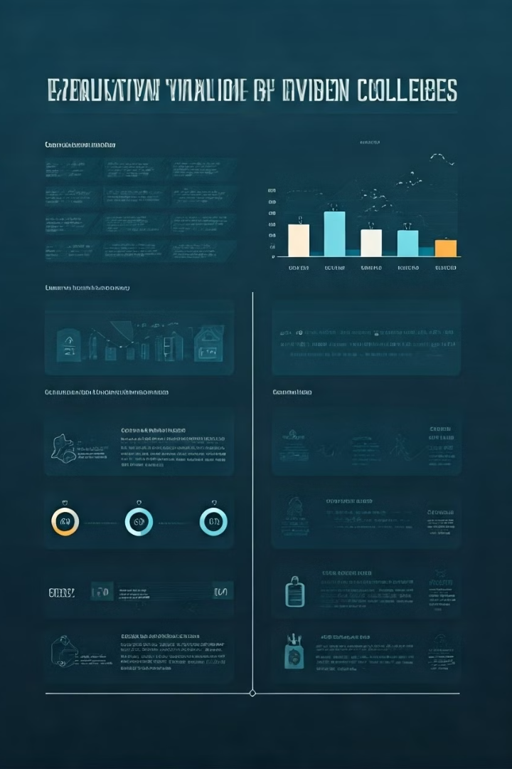




Key Metrics: What We Measure
College Details
Academic Reputation
Financials
Name, location, Placement record , type
Tuition Fees, Scholarships.
NIRF Ranking, Accreditation.
Student Reviews
Ratings from Shiksha, Quora, Social Media.

Slide 5
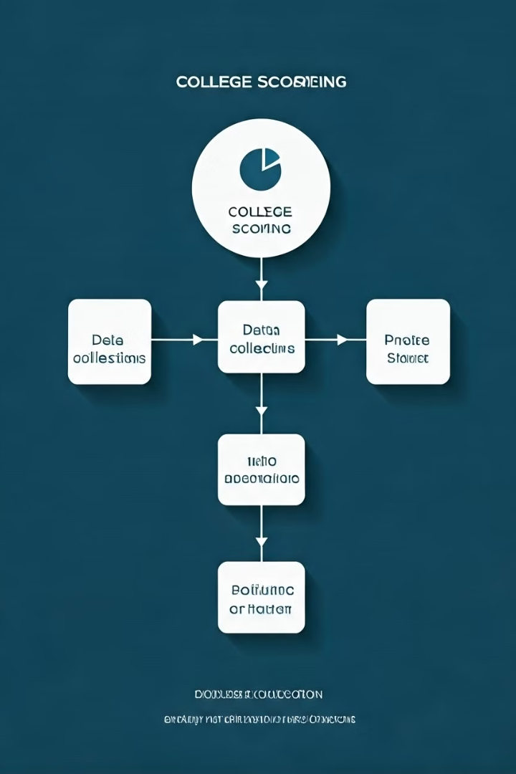




Methodology: Scoring Formula
Data Collection
Scrape data from NIRF, AICTE, Shiksha, Quora.
Preprocessing
Clean, normalize, and extract insights.
Scoring Formula
College Score = (w₁ * Placement) + (w₂ * NIRF Rank) + (w₃ * Fees) + (w₄ * Reviews)
Model Development
Use Regression to predict scores.

Slide 6
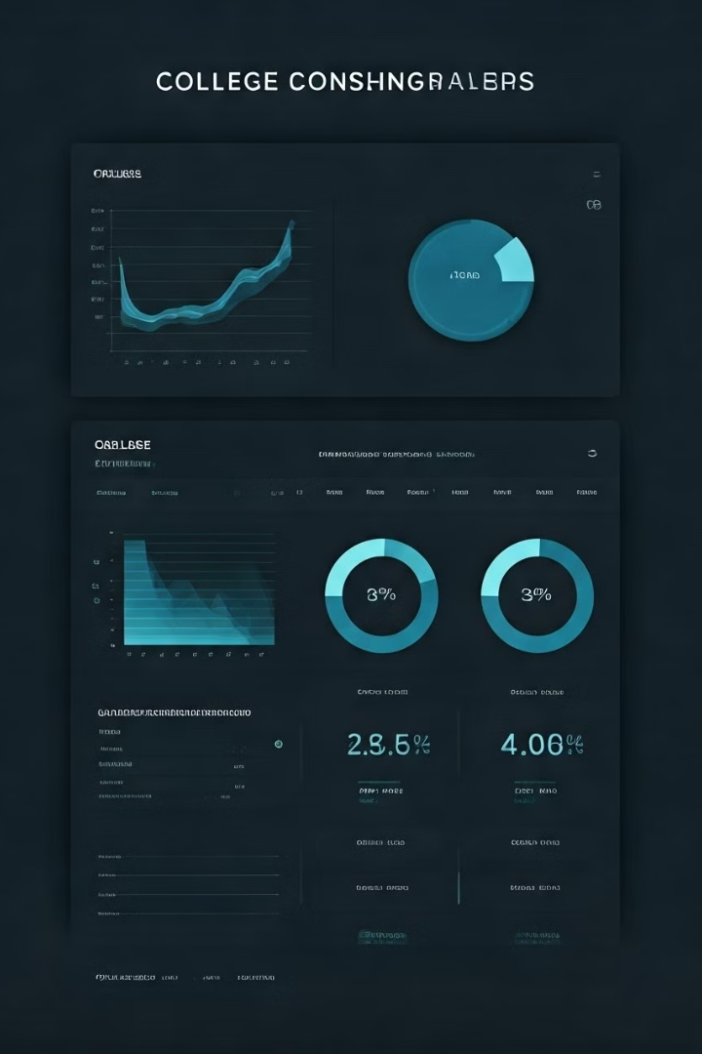
Results & Insights: Data-Driven Decisions
Top Colleges
Placement Trends
Identified based on overall scores.
Higher-ranked colleges show better rates.
Fees vs. ROI
Some private colleges charge high fees with lower ROI.

